Slide 1
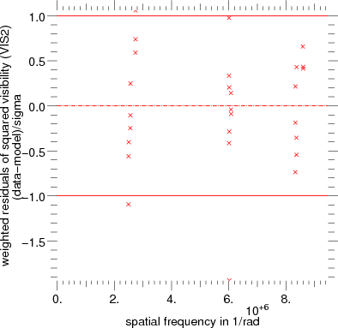
Exercise - simple fit
1.1
arcturus.1.79mu.oifits
+ disk
Good fit
reduced Chi2: initial= 3.746e+04-
final= 0.4392 - sigma= 0.2828
Number of degrees of freedom = 25
Number of iterations: 9 (max number= 200)
Final values and standard deviation for fitted parameters:
diameter1 = 20.348 +/- 0.0177 mas
Residuals

Slide 2
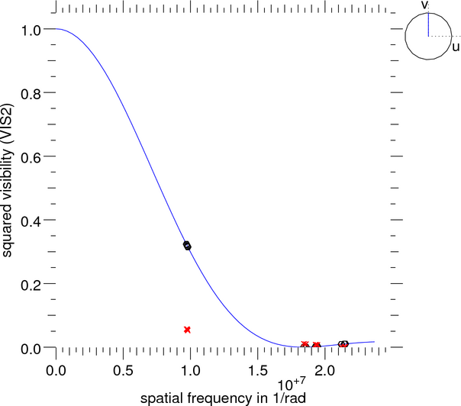
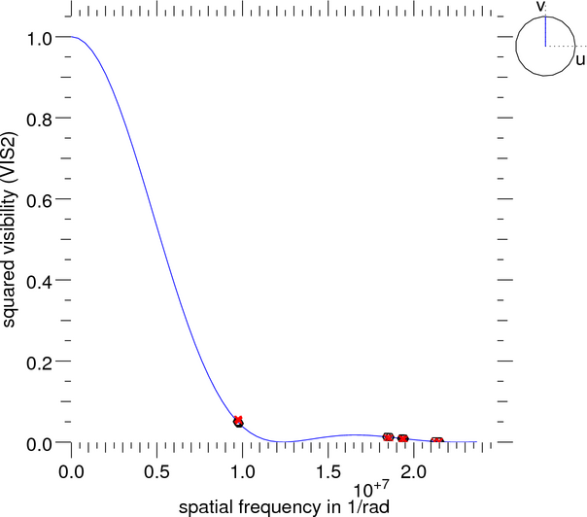
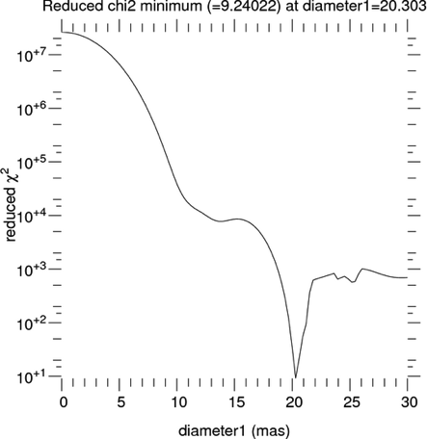
Exercise 1- simple fit
1.2
arcturus.1.52mu.oifits
+ disk
with initial diameter value = 0
with initial
diameter value = 20mas
Bad fit
Good fit ?
Plot Chi2 1D
reduced Chi2: initial= 3.588e+07 -
final= 1.043e+04 - sigma= 0.267
diameter1 = 13.694 +/- 0.445 mas
No !
reduced Chi2: initial= 1311 - final= 11.87 - sigma= 0.267
diameter1 = 20.333 +/- 0.0398 mas
local minimum
minimorum
And have a look on the residuals of the fit…
diameter

Slide 3
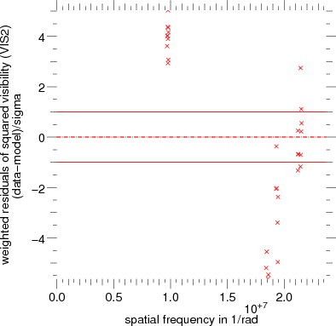
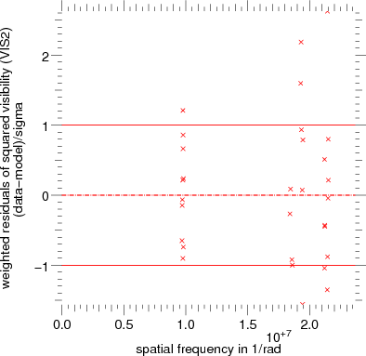
Exercise 1- simple fit
1.2
arcturus.1.52mu.oifits
+ disk
arcturus.1.52mu.oifits
+ limb_power
Weighted residuals of VIS2
Better fit
model
data
reduced Chi2: initial= 1311 –
final= 11.87 - sigma= 0.267
diameter1 = 20.333 +/- 0.0398 mas
reduced Chi2: initial= 48.56 -
final= 1.099 - sigma= 0.272
diameter1 = 20.68 +/- 0.0266 mas
power1 = 0.22869 +/- 0.0145
Notes:
Réponse à la question : y-a-t-il un minimum local sur le diamètre lorsque limb_power est optimal ? La réponse est oui.

Slide 4
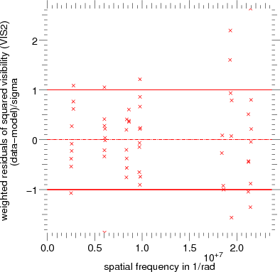
Exercise 2 - Fit with sharing of parameter
2 curves
Notes:
Remarque à remonter à Guilaume pour la non complétude d’un des 2 plots, les données s’arretant à la frequence d’1.e7 1/rad : il faudrait que le GUI prenne la CUTOFF frequency la plus grande sur l’ensemble des données (cf. plot_radial_model).

Slide 5
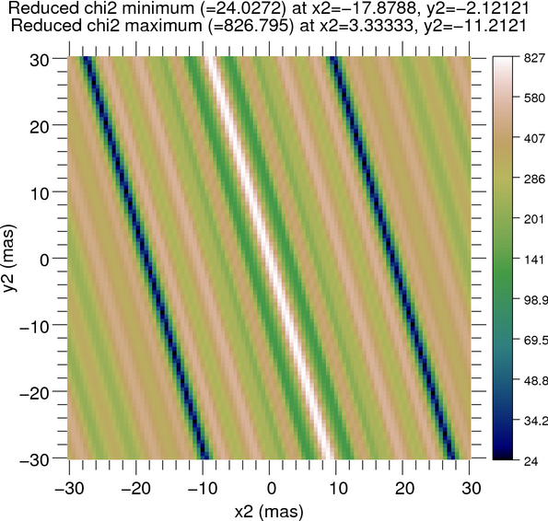
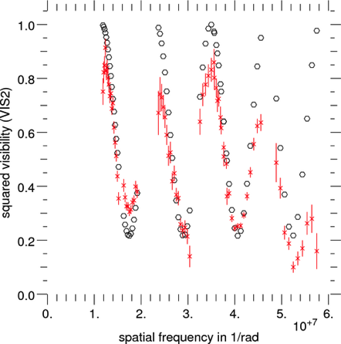
Exercise 3 - Fit with degeneracies
3.2
Theta1Ori2007Dec03_2.fits
Plot Chi2 2D, x₂, y₂
infinity of [x2, y2] giving the same Chi2 minimum
➔no single solution = degeneracy
[x2, y2] are correlated
Exemple of a result of a fit:
flux_weight1 = 0.73235 +/- 0.395
flux_weight2 = 0.26765 +/- 0.145
x2 = -9.7938 +/- 3.7e+04 mas
y2 = -29.335 +/- 1.24e+05 mas
reduced Chi2 final= 23.59 - sigma= 0.161165
--- Correlation matrix ---
i1 i2 x2 y2
i1 1 0.99 0.062 -0.062
i2 0.99 1 -0.023 0.023
x2 0.062 -0.023 1 -1
y2 -0.062 0.023 -1 1

Slide 6
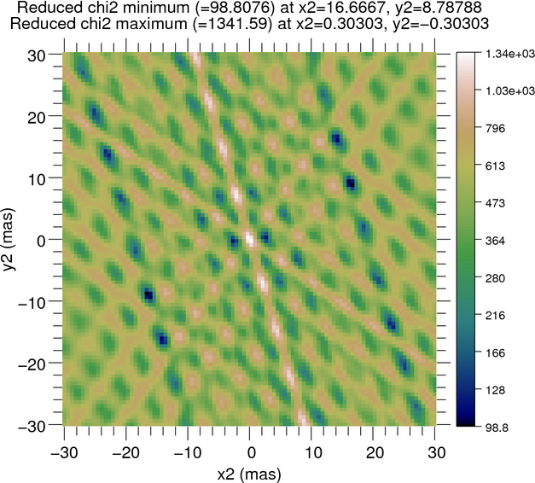
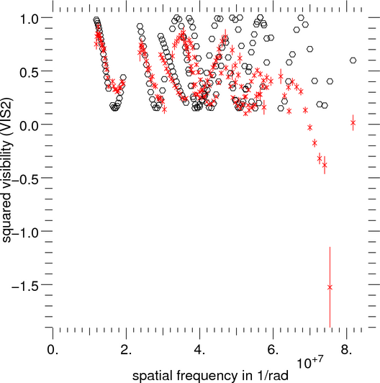
Exercise 3-3
Plot Chi2 2D, x₂, y₂
Theta1Ori2007Dec03_2.fits
+ Theta1Ori2007Dec05_2.fits
2 minimorum
2 [x₂, y₂]
possible for
initiate the fit
2 equivalent solutions
flux_weight1 = 0.69414 +/- 0.49
flux_weight2 = 0.30586 +/- 0.216
x2 = 16.364 +/- 0.047 mas or -16.364
y2 = 9.092 +/- 0.0709 mas or -9.092
i.e. [ρ, PA] = [18.72mas, 60.94°] or [18.72mas, 240.94°]
reduced Chi2 final= 81.53

Slide 7
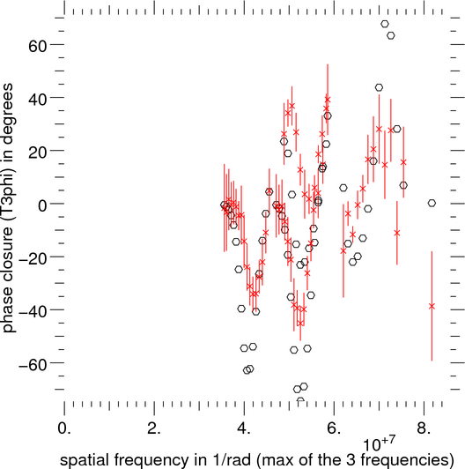
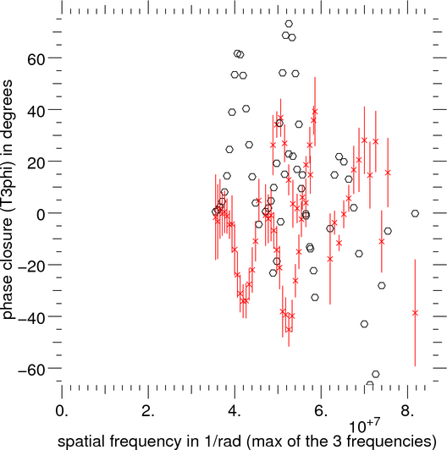
Exercise 3-4
Theta1Ori2007Dec03_2.fits
+ Theta1Ori2007Dec05_2.fits
VIS2 + T3Phi
Only one best solution :
flux_weight1 = 0.6975 +/- 0.37
flux_weight2 = 0.3025 +/- 0.16
x2 = -16.372 +/- 0.0406 mas
y2 = -9.0853 +/- 0.0613 mas
i.e. [ρ, PA] = [18.72mas, 241°]
flux_ratio = 0.43
reduced Chi2 final= 62.29 -
sigma= 0.096
Published results: Kraus S. et al, 2009, A&A. 497-1, pp. 195-207
Date Filter Flux ratio PA(°) ρ (mas)
T3phi
T3phi
π dephasing for the bad solution

Slide 8
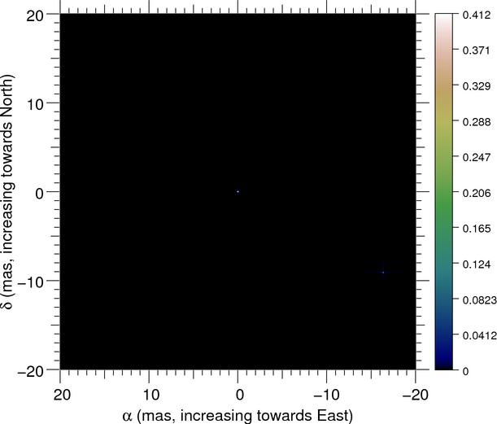
Exercise 3-4
Theta1Ori2007Dec03_2.fits
+ Theta1Ori2007Dec05_2.fits
VIS2 + T3Phi
Decreasing of VIS2 with the spatial frequency
2 puncts… but the interferometer may resolve the components of the binary since resolved components give decreasing VIS2.

Slide 9
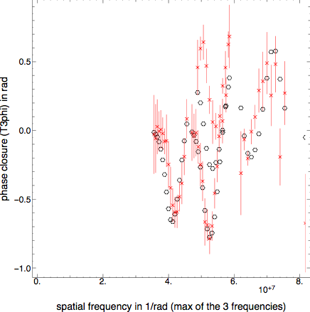
Exercise 3-4
Theta1Ori2007Dec03_2.fits
+ Theta1Ori2007Dec05_2.fits
VIS2 + T3Phi
Fit by 2 disks:
diameter1 = 2.0039 +/- 0.055 mas
diameter2 = 2.2654 +/- 0.197 mas
flux_weight1 = 0.777 +/- 0.175
flux_weight2 = 0.222 +/- 0.051
x2 = -16.389 +/- 0.0349 mas
y2 = -8.9162 +/- 0.0519 mas
i.e. [ρ, PA] = [18.66mas, -118.547 = 241.45°]
flux_ratio = 0.29
reduced Chi2: final= 11.21 - sigma= 0.09
Better T3phi fit
Better compatibility for the flux ratio with the published result (0.24)

Slide 10
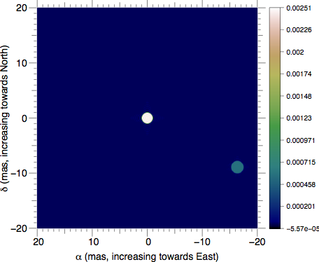
Exercise 3-4
Image of the model of Theta Ori C after a fit by 2 disks
(similar results with 2 gaussians)

Slide 11
Exercise 3- addendum
Possibility of Plot radial at different cut angles (angle =0 by default)
uv coverage
angle =
~ 35° (green) ~ 70° (magenta) ~ 125° (blue)

Slide 12
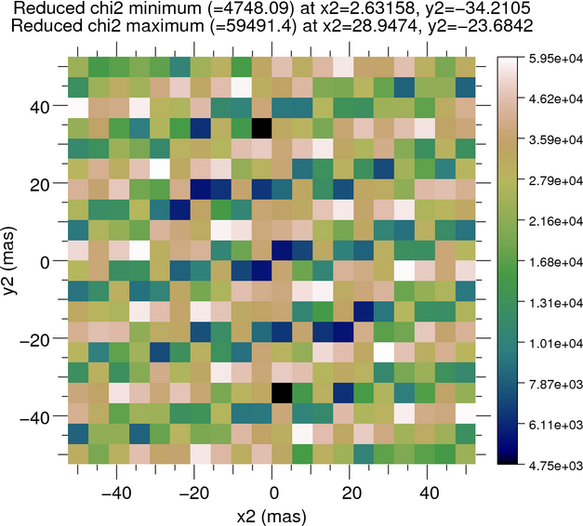
Exercise 4-1
HD87643 -K band- VIS2 + T3phi
d1 = 6.0994 +/- 0.215 mas
d2 = 5.9379 +/- 0.118 mas
fw1 = 0.37222 +/- 0.181
fw2 = 0.62778 +/- 0.305
x2 = 2.0487 +/- 0.142 mas
y2 = -33.094 +/- 0.104 mas
reduced Chi2: final= 49.92 - sigma= 0.0985329
Number of degrees of freedom = 206

Slide 13
Exercise 4-2
Fit with 2 gaussians
fw1 = 0.63794 +/- 0.279
fw2 = 0.36206 +/- 0.159
fwhm1 = 3.7853 +/- 0.0867 mas
fwhm2 = 3.7938 +/- 0.162 mas
x2 = -1.985 +/- 0.121 mas
y2 = 33.098 +/- 0.0886 mas
reduced Chi2: final= 40.51 - sigma= 0.09853
Number of degrees of freedom = 206
better chi2 than with 2 disks

Slide 14
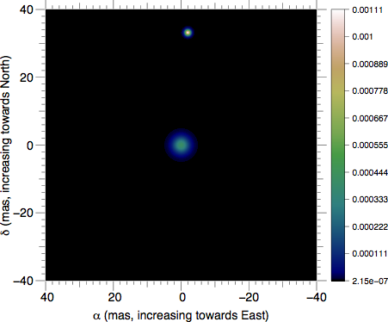
Exercise 4-3
Means to decrease the visibility at low frequencies:
by adding a dirac function, i.e. a background in the image space.
Fit by 2 gaussians and a background
fw1 = 0.62928 +/- 0.174 primary
fw2 = 0.23253 +/- 0.064 secondary
fw3 = 0.13823 +/- 0.0389 background
fwhm1 = 3.6814 +/- 0.0551 mas
fwhm2 = 1.355 +/- 0.138 mas
x2 = -1.9868 +/- 0.0503 mas
y2 = 33.178 +/- 0.0378 mas
i.e. [ρ, PA] = [33.24mas, -3.43 = 356.57°]
reduced Chi2: final= 16.27 - sigma= 0.09877
Number of degrees of freedom = 205
Separation comparable to the one published by
F.Millour et al., 2009, A&A 507, pp317-326 : [ρ, PA] = [33.48mas, 355.5°]

Slide 15
Exercise 4-4
Fit by 2 gaussians and a background: Plot radial of VIS2 and T3phi:
Improvement for the frequencies < ~3.10⁷ 1/rad only
==> better model to find for fitting the higher frequencies …

Slide 16
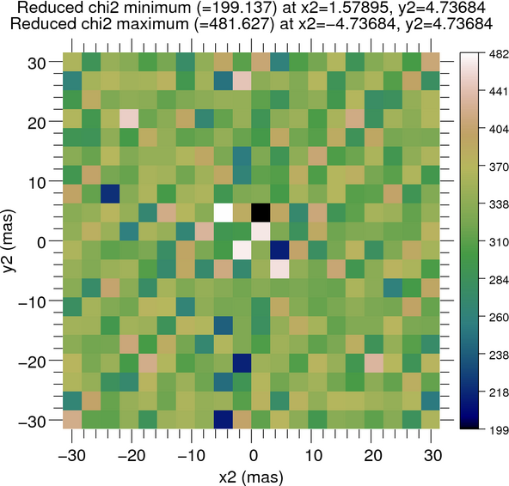
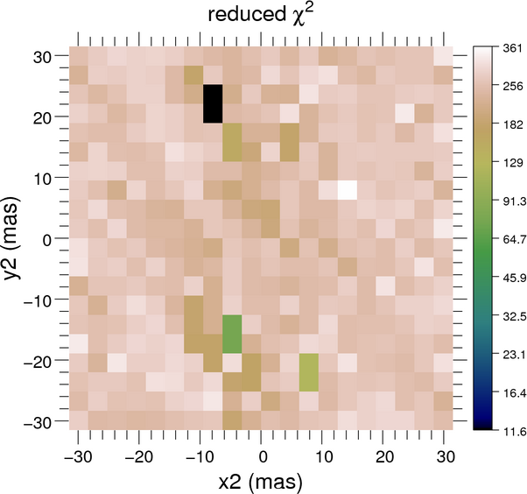
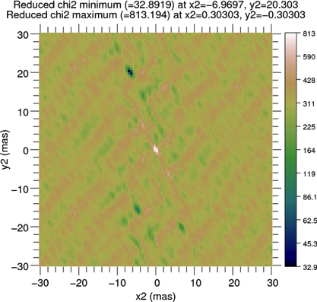
Exercise 5-1
Plot Chi2 for x2,y2 :
#samples =20
Plot Chi2 for x2,y2 :
Plot sniffer map for x2,y2 :
with fit
see the help in line
for these options
#pixscale=1

Slide 17
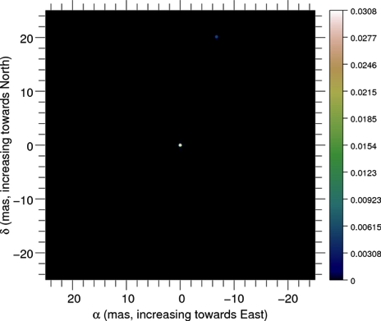
Exercise 5-2
2004-BSC1948I.fits + 2 puncts
reduced Chi2: final= 11.6 - sigma= 0.0910975
Number of degrees of freedom = 241
Final values and standard deviation for fitted parameters:
flux_weight1 = 0.83375 +/- 0.181
flux_weight2 = 0.16624 +/- 0.0362
x2 = -6.6831 +/- 0.0132mas
y2 = 20.09 +/- 0.019 mas
2004-BSC1948I.fits + 2 disks
reduced Chi2: final= 0.7564 - sigma= 0.0914779
Number of degrees of freedom = 239
Final values and standard deviation for fitted parameters:
diameter1 = 0.60975 +/- 0.006 mas
diameter2 = 0.58347 +/- 0.0411 mas
flux_weight1 = 0.85317 +/- 0.0474
flux_weight2 = 0.14683 +/- 0.00818 ➔ flux_ratio = 5.81
x2 = -6.7288 +/- 0.00424 mas
y2 = 20.135 +/- 0.00586 mas
➔ rho = 21.23 PA = 341.52 degrees
which are compatible with those given on the BC site :
21.2 mas sep., PA=341.6deg, Ratio 5.75, ud size of both components 0.6 mas.

Slide 18
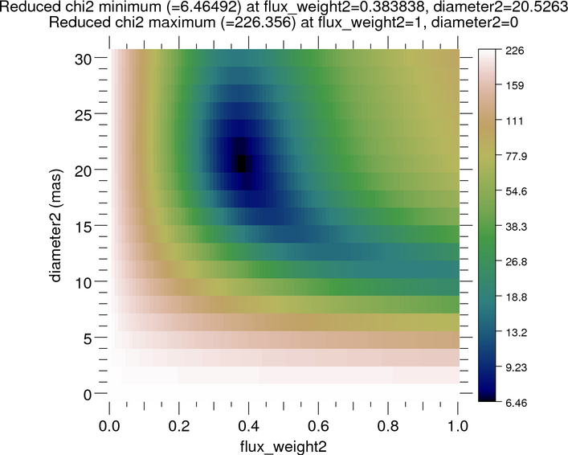
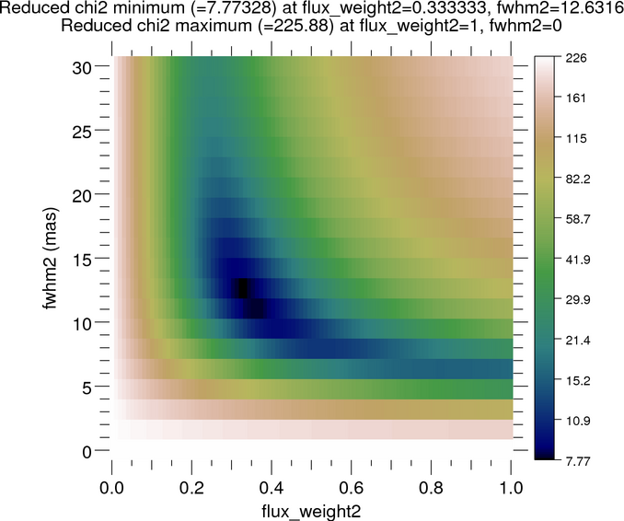
Exercise 6-1
model: punct + centered disk or gaussian
VIS2+T3amp+T3phi
fix x2, y2 to [0,0]
Plot Chi2 2D (diameter, flux_weight) or (gaussian FWHM, flux_weight) → initial guess
reduced Chi2 final= 6.302 - sigma= 0.048
diameter2 = 20.783 +/- 0.254 mas
flux_weight1 = 0.72504 +/- 0.0614
flux_weight2 = 0.27496 +/- 0.0234
reduced Chi2 final= 7.667 - sigma= 0.048
fwhm2 = 11.944 +/- 0.238 mas
flux_weight1 = 0.72504 +/- 0.0614
flux_weight2 = 0.27496 +/- 0.0234
Chi2 slightly better

Slide 19
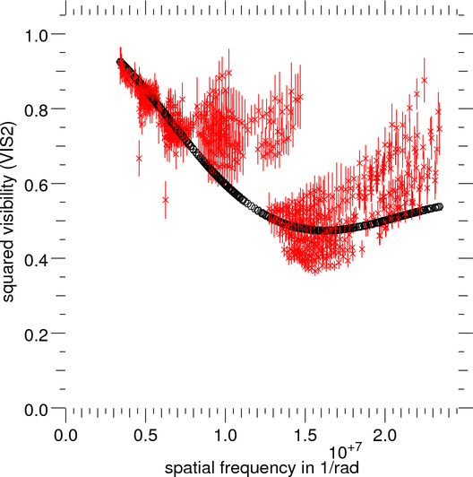
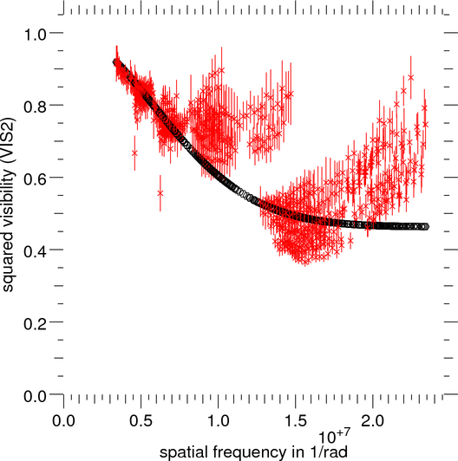
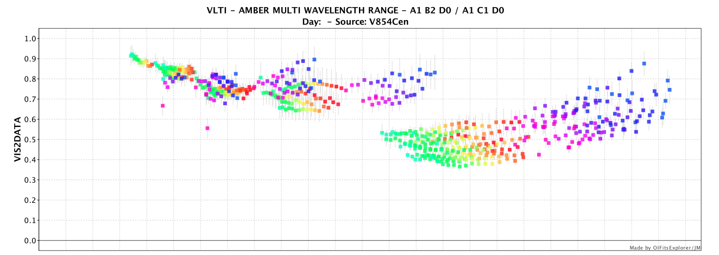
Exercise 6-2
punct + disk
punct + gaussian
Such achromatic models seem to follow a mean behaviour of the data versus the spatial frequencies
but cannot fit the "commas". Those are due to the chromatism of the data, seen using OIFits Explorer (for the moment)
9 wavelengths in [1.53- 1.8 microns]
15 wavelengths in [1.97- 2.42 microns]
16 wavelengths in [2. - 2.49 microns]

Slide 20
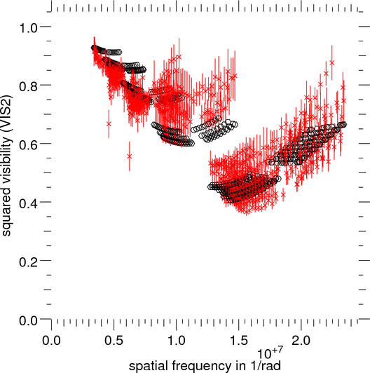

Exercise 6-3
Use of models weighted by a black body
for example :
centered punct_BB (T=6750 fixed) + disk_BB
reduced Chi2 final= 2.943 - sigma= 0.048
diameter2 = 18.203 +/- 0.222 mas
flux_weight1 = 376.63 +/- 21.8
flux_weight2 = 21.437 +/- 1.26
temperature2 = 2154.8 +/- 46.5 Kelvin
centered punct_BB (T=6750 fixed) + gaussian_BB
reduced Chi2 final= 2.722 - sigma= 0.048
fwhm2 = 10.3 +/- 0.151 mas
flux_weight1 = 352.39 +/- 19.7
flux_weight2 = 25.072 +/- 1.42
temperature2 = 1917.5 +/- 34.7 Kelvin
Chi2 slightly better
take care to not bound the flux_weights, which are not the flux_ratio, see last slide

Slide 21
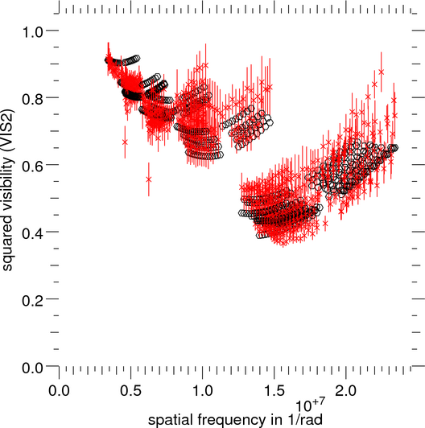
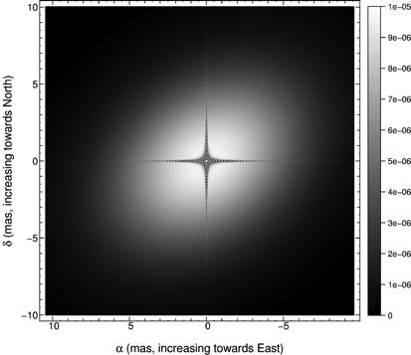
Exercise 6-4
To compare with the published results
Chesneau O., Millour F. et al., A&A 569, L4 (2014)
centered punct_BB (T₁=6750 fixed) + stretched gaussian_BB
reduced Chi2 final= 2.128 - sigma= 0.048
fwhm2 = 10.814 +/- 0.192 mas
flux_weight1 = 325.89 +/- 16.4
flux_weight2 = 31.273 +/- 1.86
stretch_pos_angle2 = 35.785 +/- 1.16 degree
stretch_ratio2 = 0.72009 +/- 0.0119
temperature2 = 1606.2 +/- 35.6 Kelvin
Our best-match model for the compact array is a two-component model, consisting of an unresolved uniform disk (Θ ≤ 2.5 mas, star component), and a flattened Gaussian (shell component) with a FWHM of the minor axis of 8 ± 1 mas, and a major axis of 11 ± 3 mas.
The orientation of the major axis is 126 ± 29◦. The quality of the fit is relatively good with a reduced χ2 of 1.5.
➔ stretch_ratio=0.72
orientation of the major axis =126-90 =36 deg.
Compatibility (except for chi2 value)
Notice: the flux
of the stretched gaussian is very low. Plot image does not allow to see it like this.
(todo for next release, e.g. adding plot keywords)

Slide 22
Exercise 6-5
To calculate the flux of the star relative to the total flux, at a given wavelength :
with ϕ1= flux_weight1, ϕ2= flux_weight2, and P_{N} the normalized Planck function.
The star flux relative to the total flux steadily decreases from 85% at 1.53 μm to 42% at 2.49 μm ,
while the shell relative flux increases from 15% to 58%, respectively, with photometric errors at the level of 25%.
➔ compatibility with the paper results.

